Slide 1

Capstone Project-2 On Retail Sales Prediction
Sandeep Salunke
(Cohort Enlighten)

Slide 2
PROBLEM STATEMENT
Rossmann operates over 3,000 drug stores in 7 European countries. Currently, Ross*mann store managers are tasked with predicting their daily sales for up to six weeks in advance. Store sales are influenced by many factors, including promotions, competition, school and state holidays, seasonality, and locality. With thousands of individual managers predicting sales based on their unique circumstances, the accuracy of results can be quite varied.
You are provided with historical sales data for 1,115 Rossmann stores. The task is to forecast the "Sales" column for the test set. Note that some stores in the dataset were temporarily closed for refurbishment

Slide 3
Work Flow :
So we will divide our work flow into following 3 steps.
Data Collection and Understanding
Data Cleaning and Manipulation
Exploratory Data Analysis(EDA)
Hypothesis Testing
Feature engineering and Data preprocessing
ML Model Implementation
EDA will be divided into following 3 analysis.
1) Univariate analysis: Univariate analysis is the simplest of the three analyses where the data you are analyzing is only one variable.
2) Bivariate analysis: Bivariate analysis is where you are comparing two variables to study their relationships.
3) Multivariate anlysis: Multivariate analysis is similar to Bivariate analysis but you are comparing more than two variables.
Hypothesis Testing is also main component in the project
Feature engineering and Data preprocessing includes such as handling null values,missing values as well as some new table creation,table manupulation etc
Last step is the Machine Learning Model implementation which is most important in our project

Slide 4
Data Collection and Understanding:
Data Description:
Id - an Id that represents a (Store, Date) duple within the test set
Store - a unique Id for each store
Sales - the turnover for any given day (this is what you are predicting)
Customers - the number of customers on a given day
Open - an indicator for whether the store was open: 0 = closed, 1 = open
StateHoliday - indicates a state holiday. Normally all stores, with few exceptions, are closed on state holidays. Note that all schools are closed on public holidays and weekends. a = public holiday, b = Easter holiday, c = Christmas, 0 = None
SchoolHoliday - indicates if the (Store, Date) was affected by the closure of public schools
StoreType - differentiates between 4 different store models: a, b, c, d
Assortment - describes an assortment level: a = basic, b = extra, c = extended

Slide 5
Data Collection and Understanding:
CompetitionDistance - distance in meters to the nearest competitor store
CompetitionOpenSince[Month/Year] - gives the approximate year and month of the time the nearest competitor was opened
Promo - indicates whether a store is running a promo on that day
Promo2 - Promo2 is a continuing and consecutive promotion for some stores: 0 = store is not participating, 1 = store is participating
Promo2Since[Year/Week] - describes the year and calendar week when the store started participating in Promo2
PromoInterval - describes the consecutive intervals Promo2 is started, naming the months the promotion is started anew. E.g. "Feb,May,Aug,Nov" means each round starts in February, May, August, November of any given year for that store

Slide 6
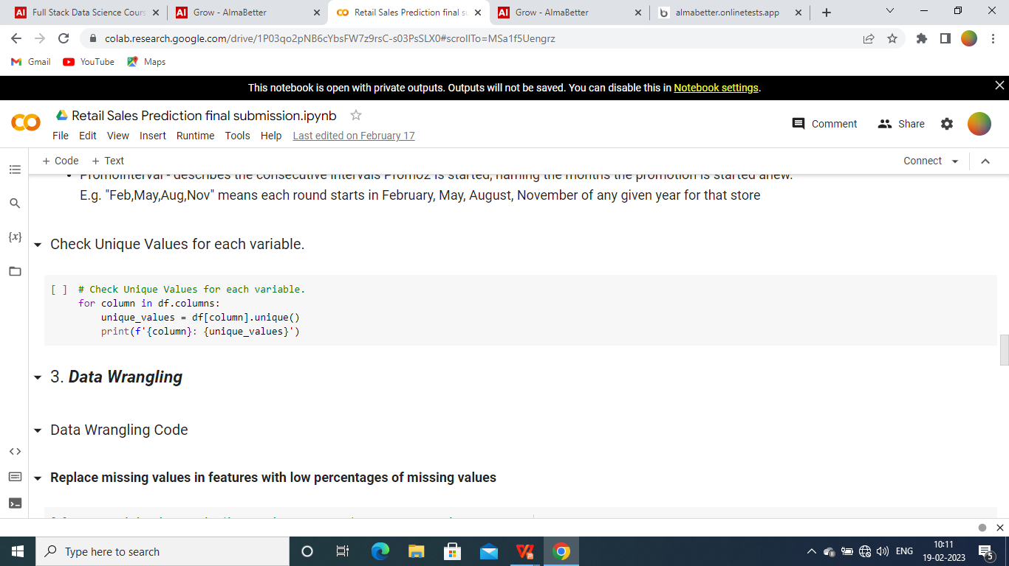
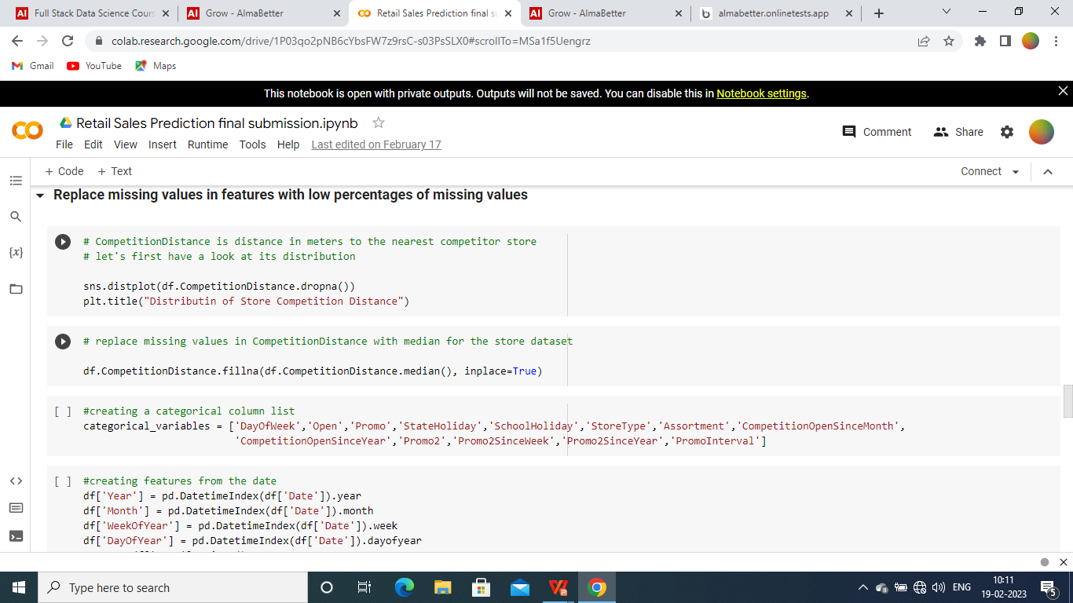
DATA MANUPULATION AND HANDLING:

Slide 7

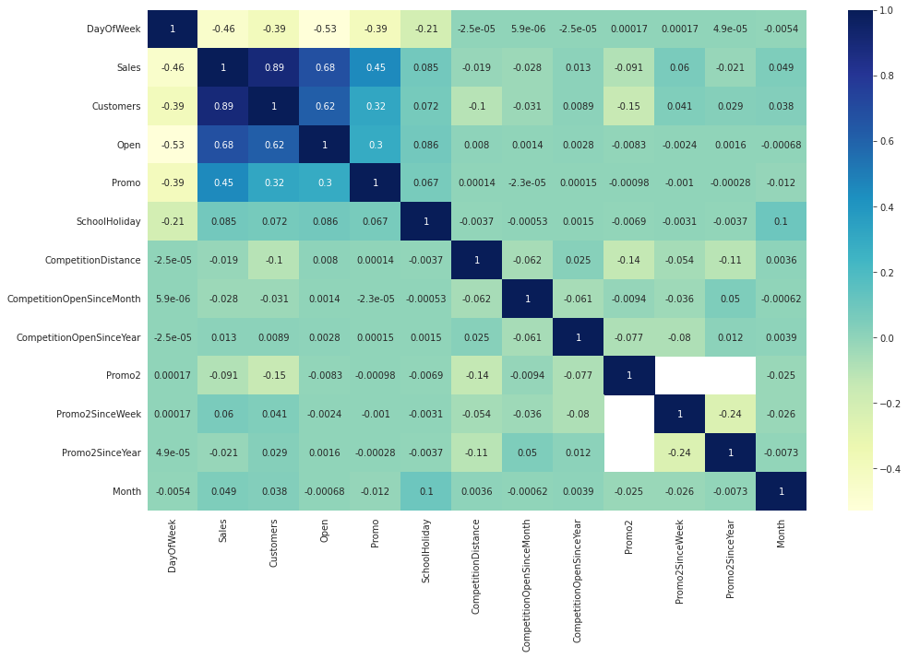
correlation matrix

Slide 8
1.Day of the week has a negative correlation indicating low sales as the weekends, and promo, customers and open has positive correlation.
2.State Holiday has a negative correlation suggesting that stores are mostly closed on state holidays indicating low sales.
3.CompetitionDistance showing negative correlation suggests that as the distance increases sales reduce, which was also observed through the scatterplot earlier.
4.There's multicollinearity involved in the dataset as well. The features telling the same story like Promo2, Promo2 since week and year are showing multicollinearity.
5.The correlation matrix is agreeing with all the observations done earlier while exploring through barplots and scatterplots.

Slide 9

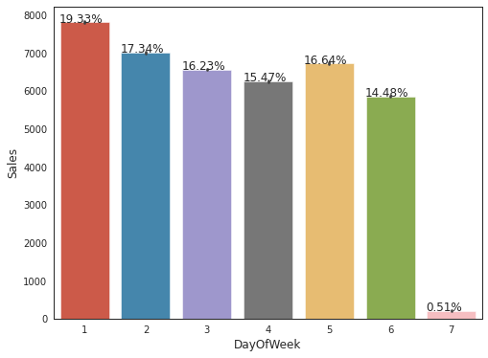
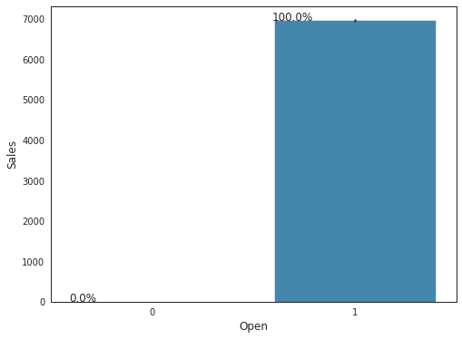
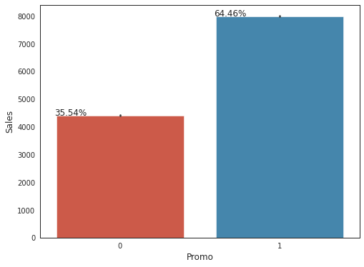
Exploratory Data Analysis(EDA)

Slide 10
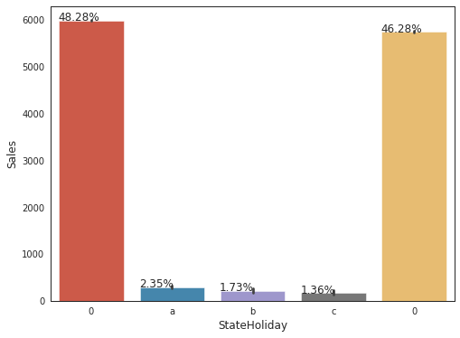
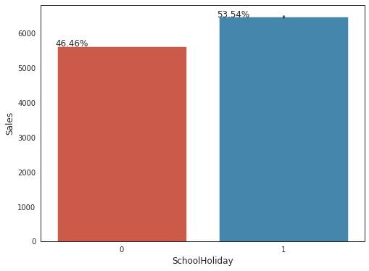
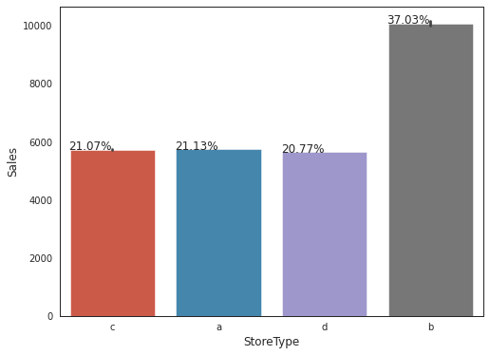
Exploratory Data Analysis(EDA)

Slide 11
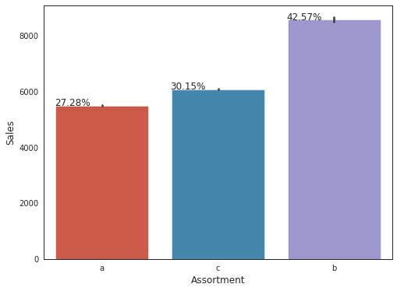
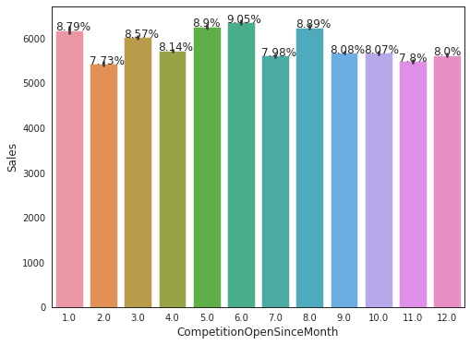
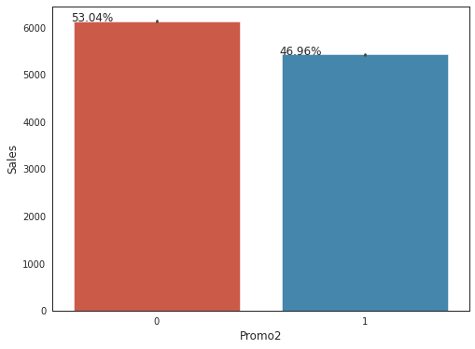
Exploratory Data Analysis(EDA)

Slide 12

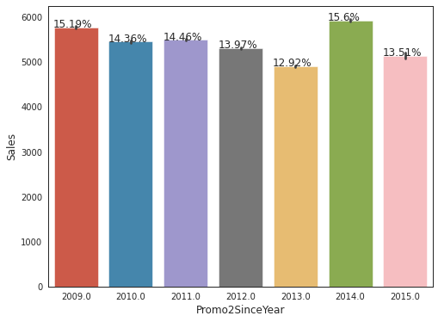
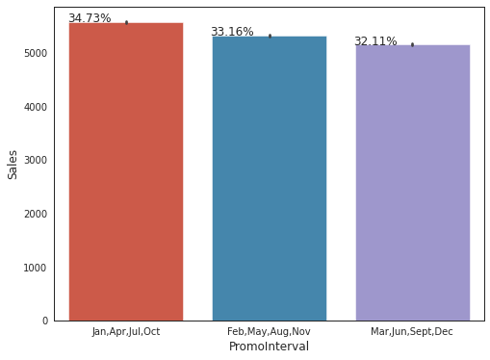
Exploratory Data Analysis(EDA)

Slide 13
Exploratory Data Analysis(EDA)
Observations –
There were more sales on Monday, probably because shops generally remain closed on Sundays.
It could be seen that the Promo leads to more sales.
Normally all stores, with few exceptions, are closed on state holidays. Note that all schools are closed on public holidays and weekends. a = public holiday, b = Easter holiday, c = Christmas, 0 = None. Lowest of Sales were seen on state holidays especially on Christmas.
More stores were open on School Holidays than on State Holidays and hence had more sales than State Holidays.
On an average Store type B had the highest sales.
Highest average sales were seen with Assortment levels-b which is 'extra'.
With Promo2, slightly more sales were seen without it which indicates there are many stores not participating in promo.

Slide 14
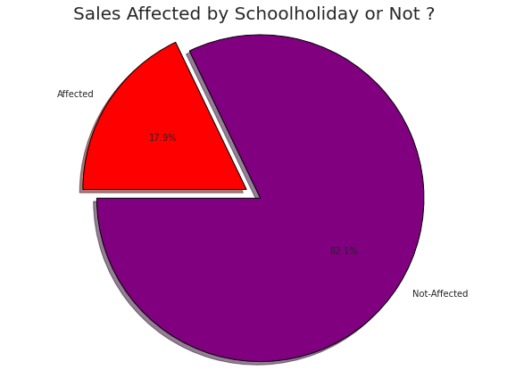
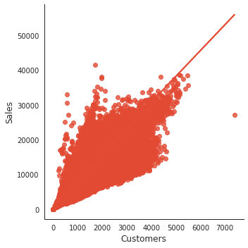
Exploratory Data Analysis(EDA)
observations
1.82.1% sales are not affected and only 17.9% sales is affected because of schoo holiday
2.As we can see their is linear relationship between customers and sales as customers increasing sales also increasing

Slide 15
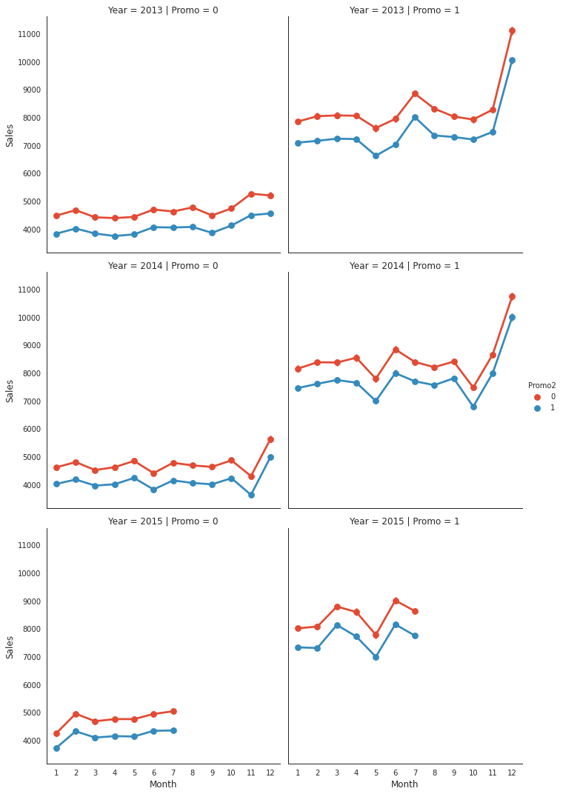
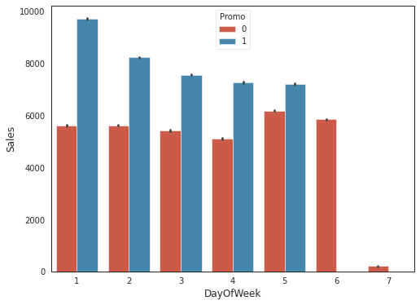
Exploratory Data Analysis(EDA)
1.Here we can see that if their is no promo the sales is very less and if promo running their the sales is high.
2.Their is large diffrence on monday and it is decreasing day by day and on sunday their is no sales so it shwing less.

Slide 16
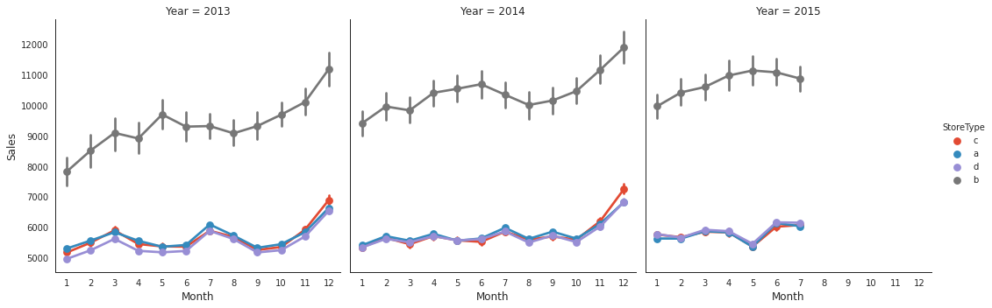
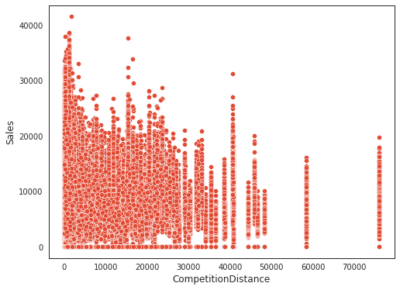
Exploratory Data Analysis(EDA)

Slide 17
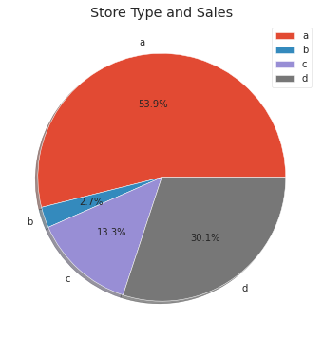
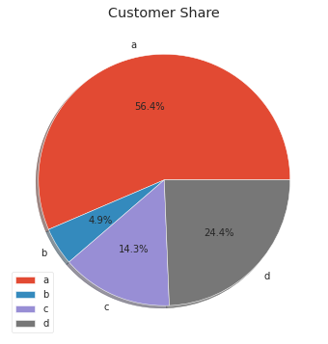
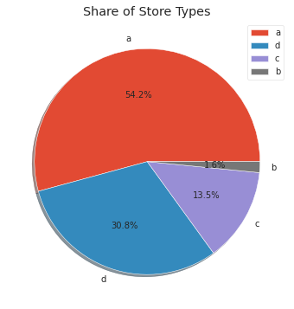
Exploratory Data Analysis(EDA)
Observations –
1.In 2013 and 2014 their is some increasing in the sales but in 2015 their is some decreasing in trend of sales over the months
2.From the above scatter plot it can be observed that mostly the competitor stores weren't that far from each other and the stores densely located near each other saw more sales
3.A bar plot represents an estimate of central tendency for a numeric variable with the height of each rectangle. Earlier it was seen that the store type b had the highest sales on an average because the default estimation function to the barplot is mean.
4.But upon further exploration it can be clearly observed that the highest sales belonged to the store type a due to the high number of type a stores in our dataset. Store type a and c had a similar kind of sales and customer share.
5.Interesting insight to note is that store type b with highest average sales and per store revenue generation looks healthy and a reason for that would be all three kinds of assortment strategies involved which was seen earlie

Slide 18
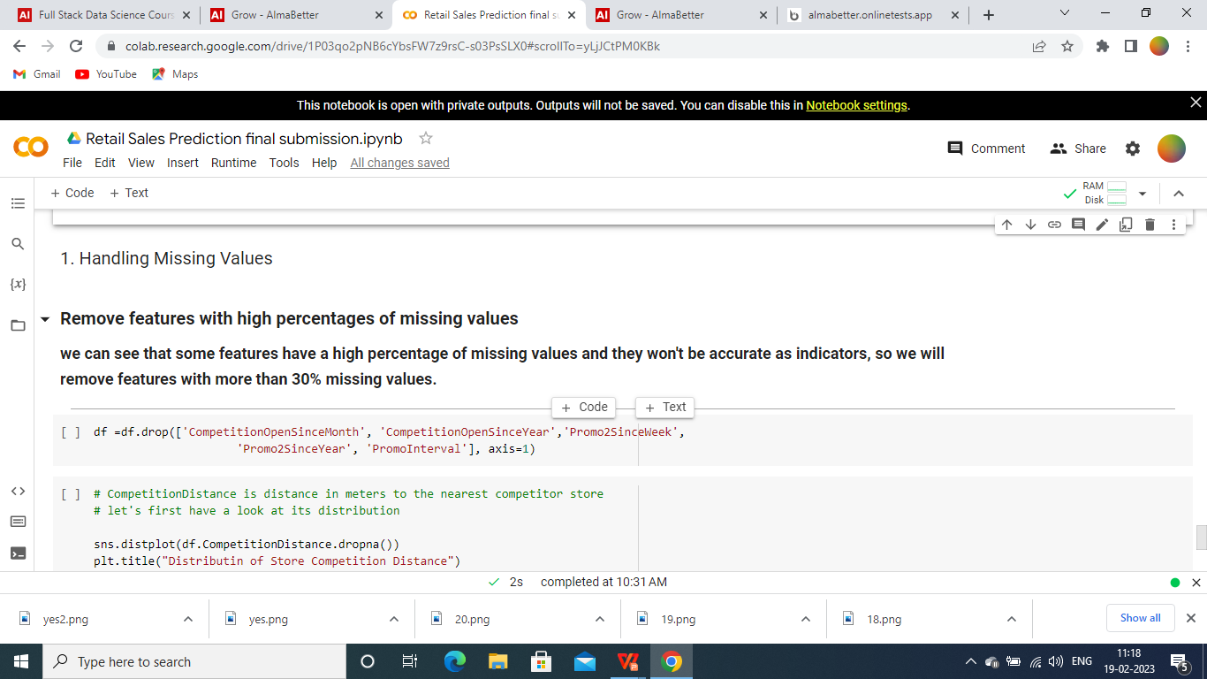
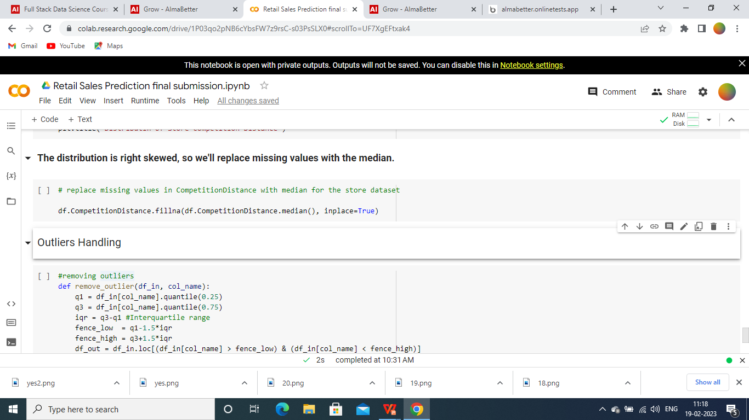
Feature Engineering

Slide 19
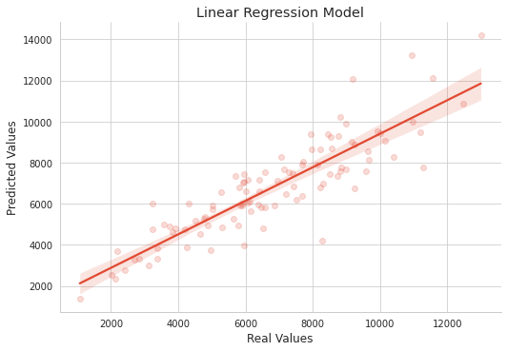

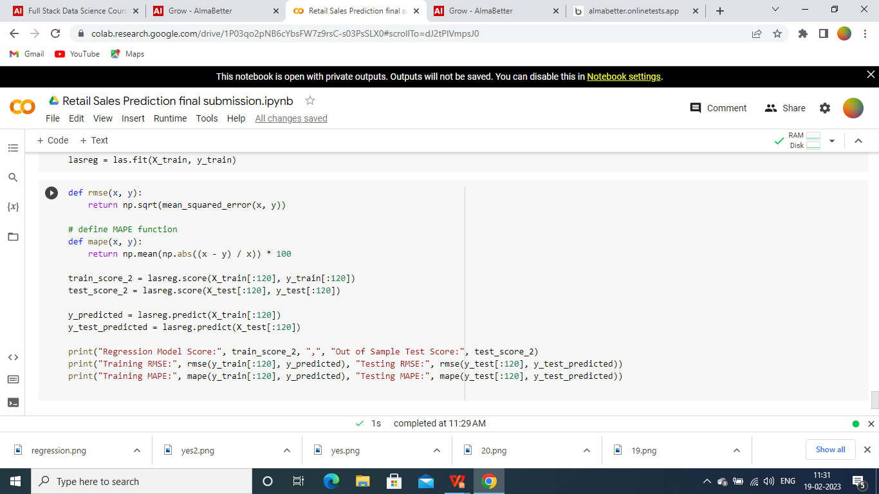
ML Model Implementation

Slide 20
Conclusion
The MSE and R2 score are commonly used evaluation metrics for regression models. In this case, the Linear Regression and Lasso Regression models have very similar performance, with the Lasso Regression model having a slightly lower MSE and a slightly higher R2 score.
The mean squared error (MSE) measures the average squared difference between the predicted and actual values, where a lower MSE indicates better performance. The R-squared (R2) score measures the proportion of the variance in the dependent variable that is predictable from the independent variables, where a higher R2 score indicates better performance.

Slide 21
THANK YOU…!!

